Slide 1
FASHION TREND ANALYSIS DASHBOARD
MTee

Slide 2

m.Tee Team
Tosin Full-Stack Developer
Mercy
Full-Stack Developer

Slide 3

Agenda
Overview
Methodology
Project Management
Conclusions

Slide 4

INTRODUCTION
The Fashion Trend Analysis Dashboard -developed by MTee - is a Full-Stack Application for analysing and visualising fashion trends.

Slide 5
OBJECTIVES
Provide trend analytics and insights to fashion business.
01
Ensure data security, integrity, and user authentication.
02
Implement a user-friendly interface for users to explore fashion trends
03

Slide 6

SIGNIFICANCE Informed Decisions Competitive Edge Inventory Efficiency Engagement & Loyalty Design Precision Risk Mitigation Consumer Empowerment Sustainability Global Insights Innovation Driver

Slide 7
methodology

Slide 8










TECHNOLOGIES

Slide 9
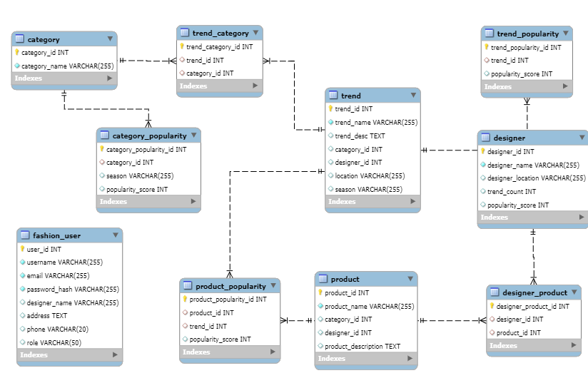
Database and ERD

Slide 10
GATHERING & IMPLEMENTING DATA
How it was done
Initial Idea
Inserted Mock Data to prevent legal issues
Using Fashion Trend APIs
Web scraping articles
Roadblocks
Fashion Trend APIs expensive or old data
Web scraping Fashion resources, all protect from looking at Robots.file

Slide 11
BACKEND

Slide 12
SPRING BOOT MVC
- Model – the dto of where we define our applications entities
-Controller – crud operations, api endpoints
-Dao – methods with queries connected to the database
-Service – returns the dao and the controller and controller calls the service (do research on MVC)
TREND
DESIGNER
CATEGORY
PRODUCT

Slide 13
USER
Model -
Controller -
Dao
Service
Secuity

Slide 14
EXCEPTIONS AND ERROR HANDLING
CustomUncheckedExceptionClass
GlobalExceptionHandler

Slide 15
UNIT TESTING
Positive and Negative Testing
Edge Cases (no values)

Slide 16
STRETCH GOALS
Roadblocks
Spring Security
User Authentication
Analysis Server
Trend interactions table
Timeframe

Slide 17
FRONT END
Roadblocks:
- Incorporating the frontend with the backend through local hosts
- CorsConfig

Slide 18
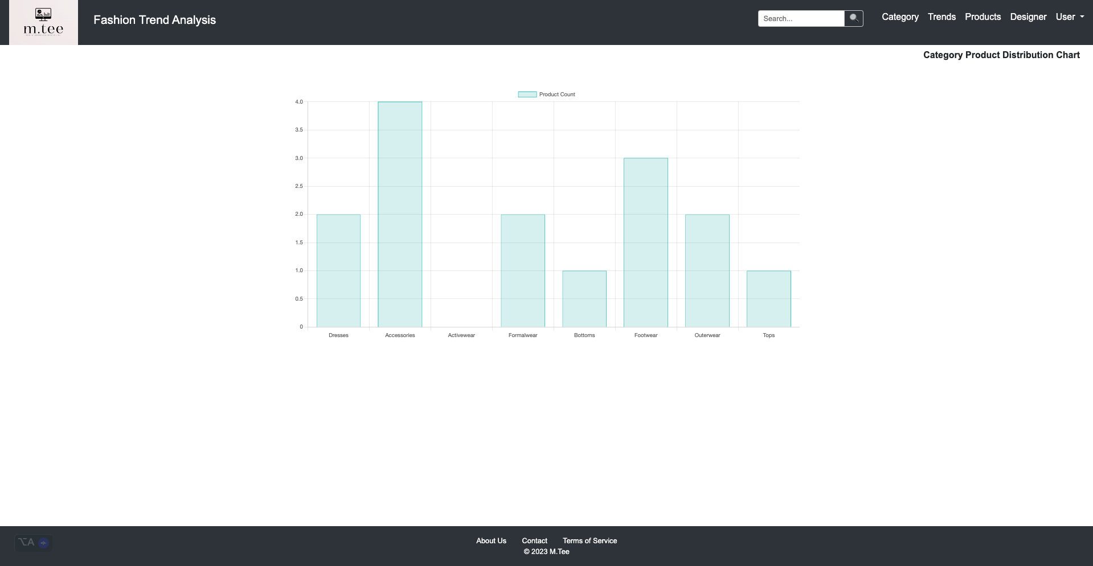

Slide 19
PROJECT MANAGEMENT
How we split tasks
How we managed the project
Git
Excel Spreadsheet
Time management

Slide 20



CONCLUSIONS
Review of Project and Project Management : what went well and even better if
What we learned
Future improvements

Slide 21




Thank you
MTee

